Slide 1



Predicting Stock Market Performance with Daily Top News Headlines
Image from: https://www.itsmfusa.org/news/
Image from: http://timesslate.com/category/business/page/1134/
Image from: https://www.clickz.com/5-businesses-using-ai-to-predict-the-future-and-profit/112336/
David Sciacca
Regis University
Data Science Practicum II – MSDS 696

Slide 2
Background
News reports can impact stock market performance (Beers, 2019)
Too many articles daily for humans
Nearly impossible for individual to be aware of everything
Impossible for person to quantify impact
Project aims to address this
Use news headlines to predict stock performance
Natural Language Processing (NLP)
Sentiment Analysis
Headline Clustering
Ascertain general content

Slide 3
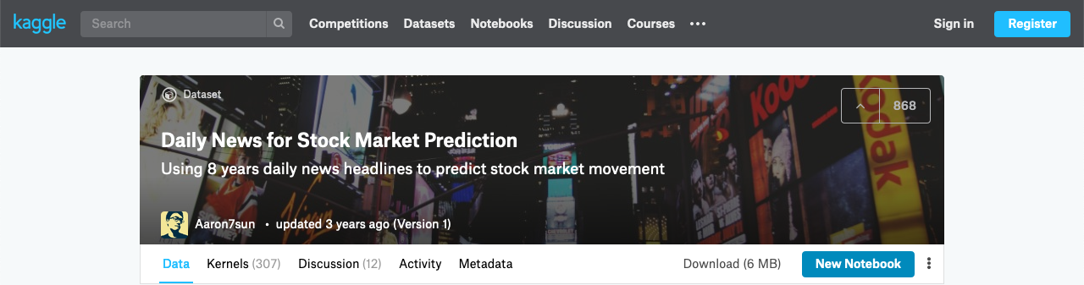
The Data
Kaggle Datasets (Aaron7sun, 2016)
Top 25 daily news headlines from June 8, 2008 to July 1, 2016
73,608 Rows by 2 Columns
Dow Jones Industrial Average (DJIA) stock performance data June 8, 2008 to July 1, 2016
1989 Rows by 7 Columns
Combined dataset w/ rows by day
1989 Rows by 27 Columns
Primarily made use of this dataset

Slide 4
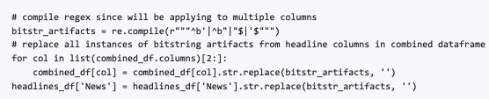
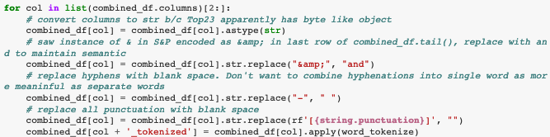
Data Cleaning
DJIA stock data already clean
No null values or similar that require cleaning
Headlines data, not so much
Some saved as bitstrings - beginning with `b’` and ending with `’`
Punctuation and other artifact removal

Slide 5
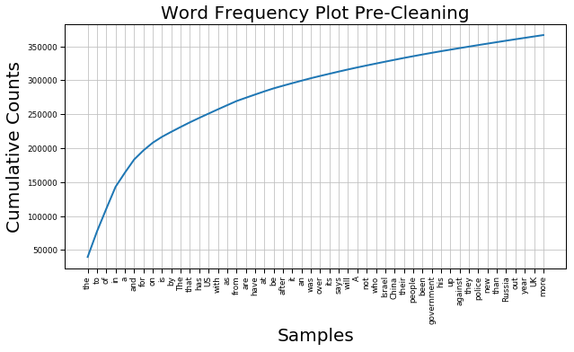
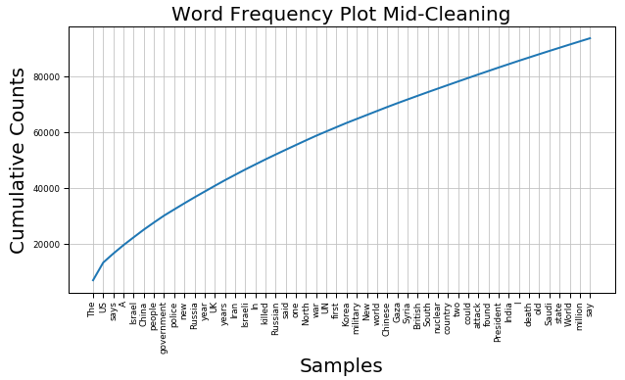
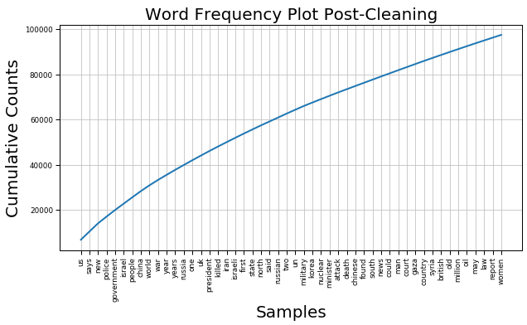
Headline Data Cleaning (cont.)
Convert to lowercase and stop word removal
Before Just stop word removal
Post cleaning

Slide 6
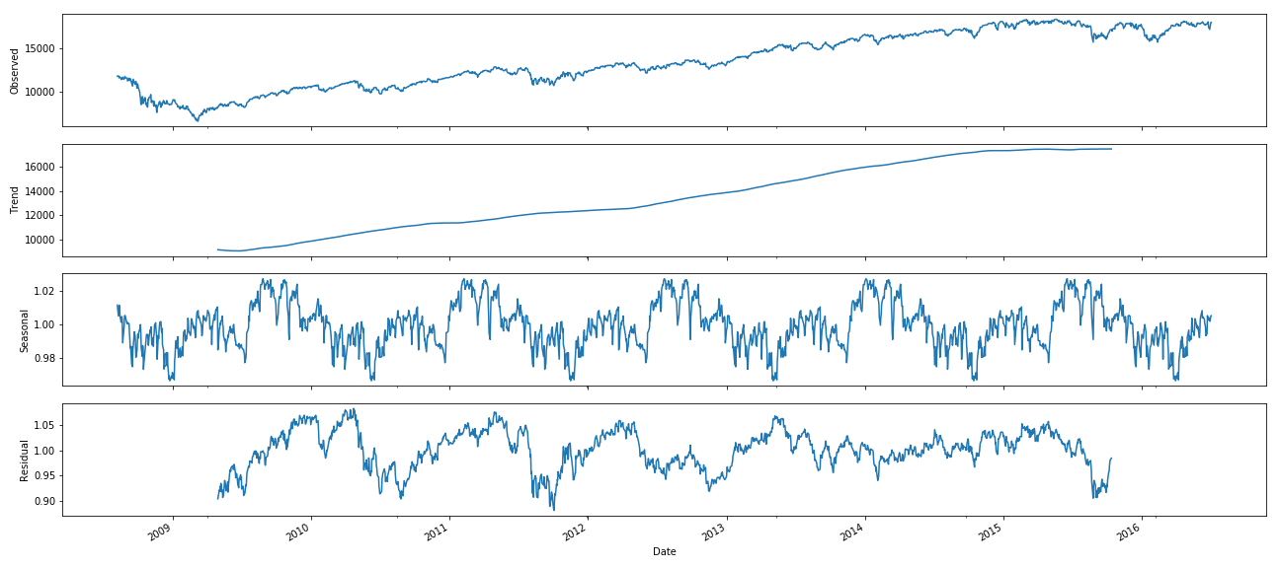
Exploratory Data Analysis
Decomposed stock data into various components

Slide 7
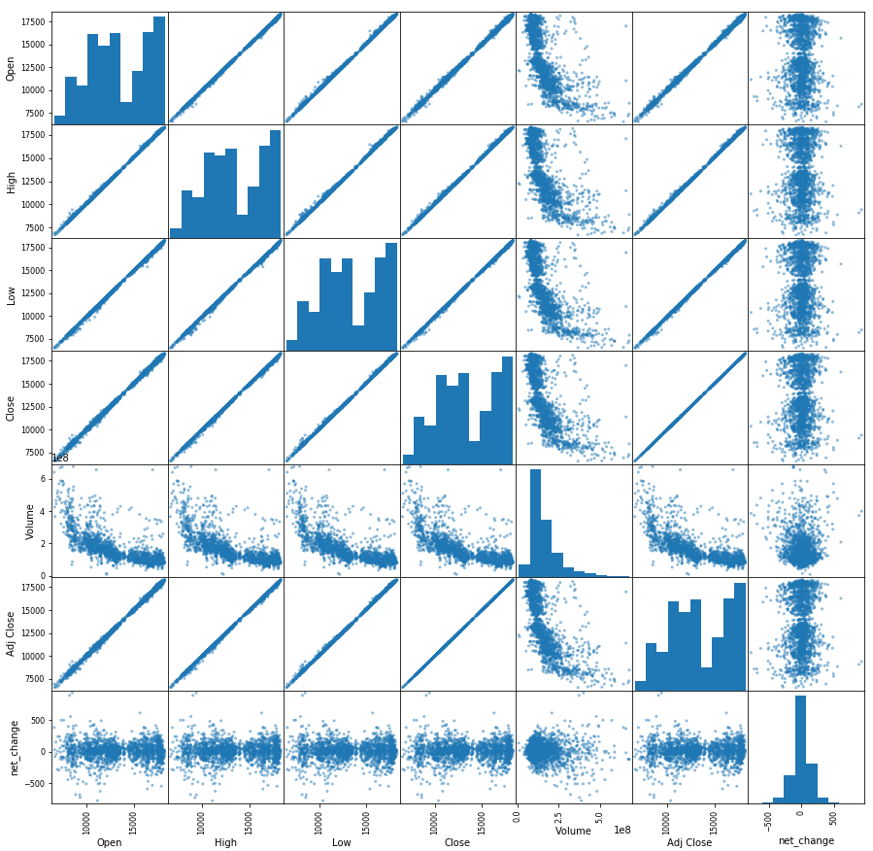
EDA (cont.)
Engineered net_change column, visualized correlations

Slide 8
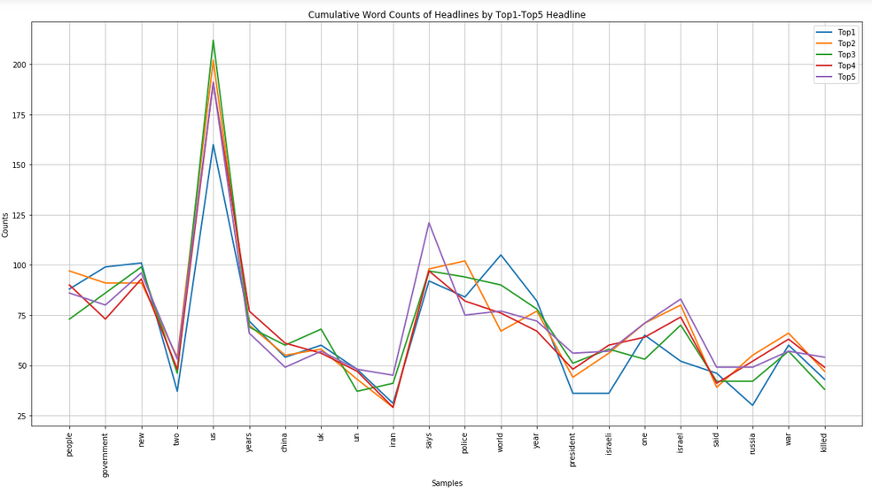
EDA (cont.)
Visualized word counts by Top# columns

Slide 9
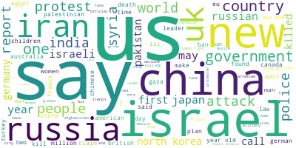
EDA (cont.)
Word Cloud of Headline Content
Visually largest are us, say, isreal, new, china, and russia
Interesting as different from top 5 seen in cumulative plot from cleaning
Did same with top 5 headline columns – no clear difference - see notebooks

Slide 10
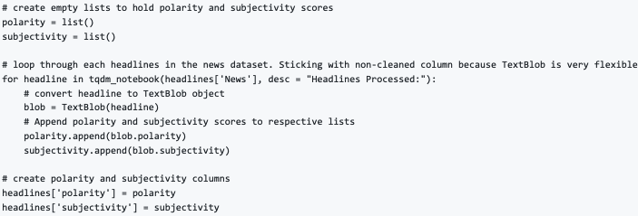
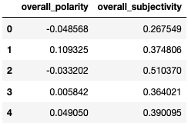
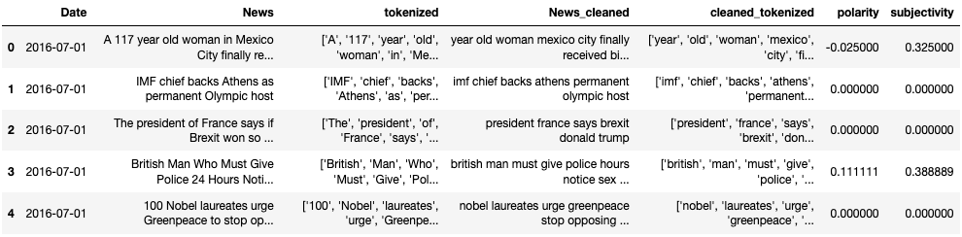
Sentiment Analysis Model
Sentiment analysis on headlines, both by headline and day
Obtained polarity and subjectivity scores

Slide 11
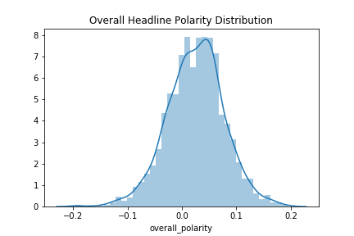
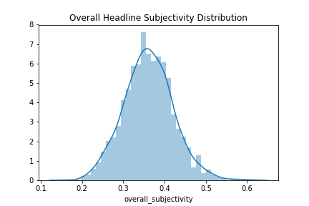
Sentiment Analysis Model (cont.)
Visualized distribution of daily polarity and subjectivity
Generally non polar – most close to 0, but tend positive
Somewhat subjective, but majority less than 0.5 out of 1 on scale

Slide 12
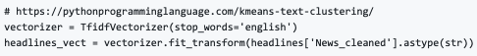
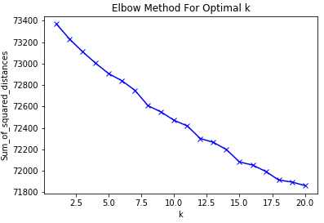
Headline Clustering Model
Assigned numeric scores to word with TfidfVectorizer
Used Elbow Method to determine optimal k for k-means clustering

Slide 13
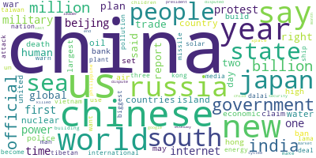


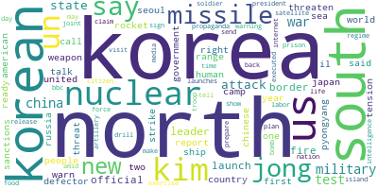
Headline Clustering Model (cont.)
Visualized clusters with Word Clouds to determine meaning

Slide 14
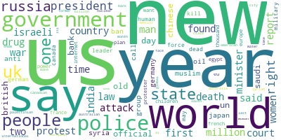
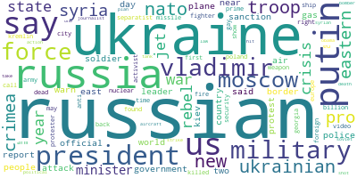

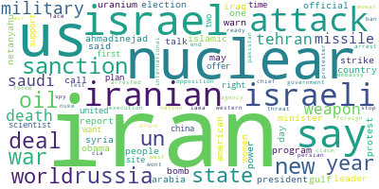
Headline Clustering Model (cont.)

Slide 15
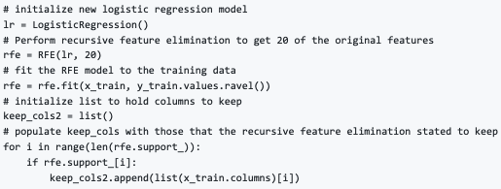
Stock Prediction Models
Linear Regression Approach
Best accuracy required Recursive Feature Elimination

Slide 16
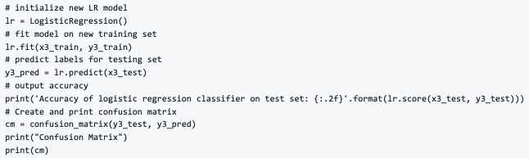
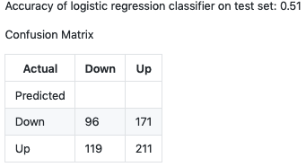
Stock Prediction Models (cont.)
Logistic Regression approach
Trained and evaluated the model

Slide 17
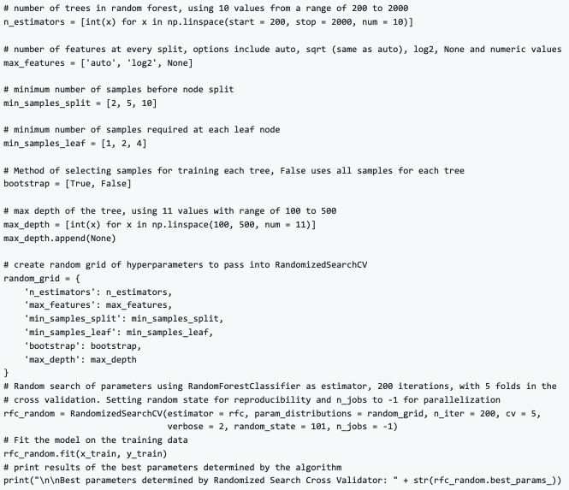
Stock Prediction Models (cont.)
Random Forest Classifier Approach
Best accuracy with RFE and hyper parameter optimization

Slide 18
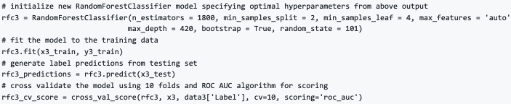
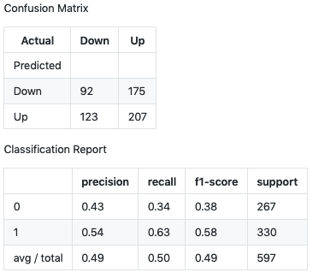
Stock Prediction Models (cont.)
Random Forest Classifier Approach
Mean AUC Score: 0.5325041101726599

Slide 19
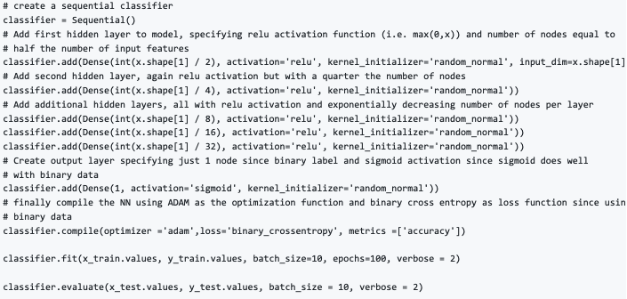
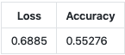
Stock Prediction Models (cont.)
Sequential Neural Network Approach
Able to train on full feature set
Tried multiple Activation Functions on Hidden Layers, best were `relu` and `elu`

Slide 20
Conclusions
Didn’t end up with models much better than random guess
Learned a lot:
Sentiment Analysis with TextBlob: news headlines mostly non-polar and fairly objective
Clustering with k-means and generating Word Clouds: Headlines typically follow common threads
Learned number of ways not to build such a model, but NN seems to be the way to go
“Our greatest weakness lies in giving up. The most certain way to succeed is to try just one more time” – Thomas Edison
Will continue work on this into the future in hopes of creating more effective models

Slide 21
The Future
Collect more data, such as data from 2016 to now
Try more feature engineering on headlines
Continue working with NN since this worked best
Create model based on stock time series data
Combine multiple “alright” models and implement voting scheme
Attempt with full article text – not just headlines

Slide 22
References
Aaron7sun. (2016, August 25). Daily News for Stock Market Prediction. Retrieved July 4, 2019, from https://www.kaggle.com/aaron7sun/stocknews
Beers, B. (2019, June 25). Why do stock prices change based on news reports? Retrieved July 4, 2019, from https://www.investopedia.com/ask/answers/155.asp

